Slide 1
Basics of Matlab Dr. SAPNA SHARMA School of Mathematics, Thapar Institute of Engineering & Technology, Patiala.

Slide 2
Matlab is a program for doing numerical computation. It was originally designed for solving linear algebra type problems using matrices. It’s name is derived from MATrix LABoratory.

Slide 3
Some other aspects of Matlab
Matlab is an interpreter -> not as fast as compiled code
Typically quite fast for an interpreted language
Often used early in development -> can then convert to C (e.g.,) for speed
Can be linked to C/C++, JAVA, SQL, etc
Commercial product, but widely used in industry and academia
Many algorithms and toolboxes freely available

Slide 4
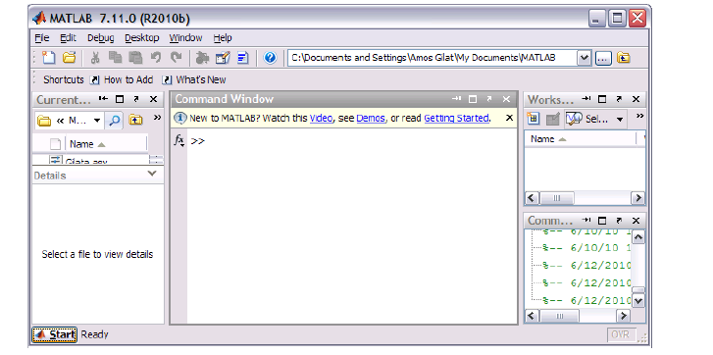

Slide 5
Current Folder — Access your files.
Command Window — Enter commands at the command line, indicated by the prompt (>>).
Workspace — Explore data that you create or import from files

Slide 6
Variables
Have not to be previously declared
Variable names can contain up to 63 characters
Variable names must start with a letter followed by letters, digits, and underscores.
Variable names are case sensitive

Slide 7
Matlab Special Variables
ans Default variable name for results
pi π
eps Smallest incremental number
inf Infinity
NaN Not a number e.g. 0/0
% used to denote a comment
; suppresses display of value (when placed at end of a statement)
... continues the statement on next line

Slide 8
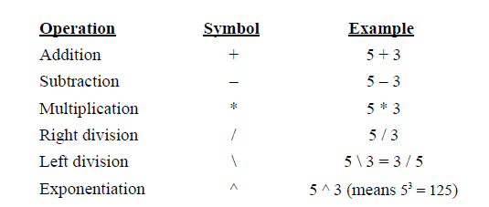
Arithmetic Operators

Slide 9
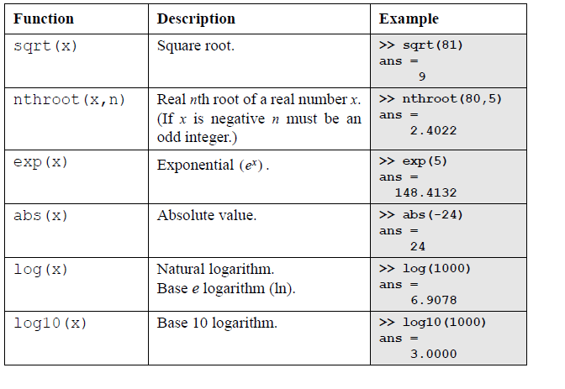

Slide 10
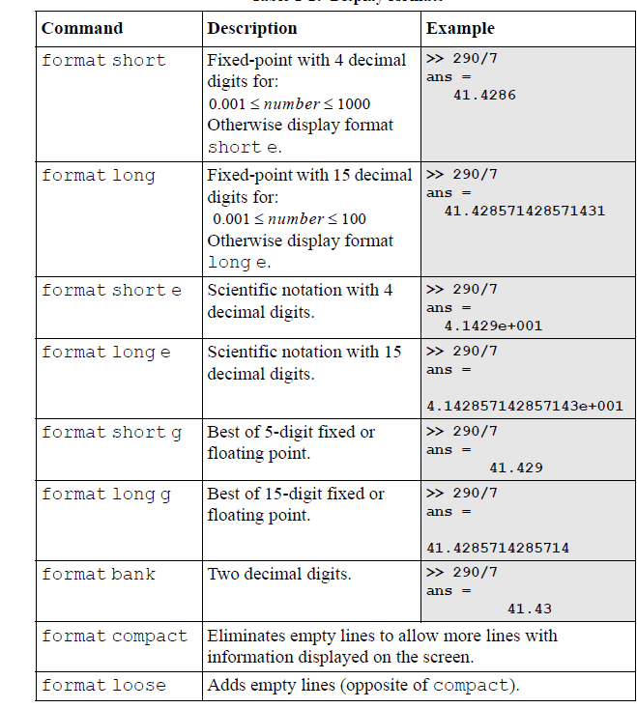

Slide 11
Matlab’s Workspace
who, whos – current workspace vars.
save – save workspace vars to *.mat file.
load – load variables from *.mat file.
clear all – clear workspace vars.
close all – close all figures
clc – clear screen
clf – clear figure

Slide 12
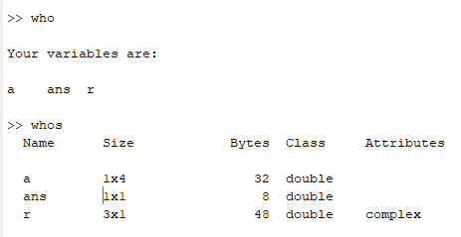

Slide 13
Arrays can be classified as vectors and matrices.
Matlab treats all variables as matrices. For our purposes a matrix can be thought of as an array, in fact, that is how it is stored.
Vectors are special forms of matrices and contain only one row OR one column.
Scalars are matrices with only one row AND one column

Slide 14
Arrays and Matrices
v = [-2 3 0 4.5 -1.5]; % length 5 row vector.
v = v’; % transposes v.
v(1); % first element of v.
v(2:4); % entries 2-4 of v.
v([3,5]); % returns entries 3 & 5.
v=[4:-1:2]; % same as v=[4 3 2];
a=1:3; b=2:3; c=[a b]; → c = [1 2 3 2 3];

Slide 15
Arrays and Matrices (2)
x = linspace(-pi,pi,10); % creates 10 linearly-spaced elements from –pi to pi.
logspace is similar.
A = [1 2 3; 4 5 6]; % creates 2x3 matrix
A(1,2) % the element in row 1, column 2.
A(:,2) % the second column.
A(2,:) % the second row.

Slide 16
Creating special matrices
diag(v) % change a vector v to a diagonal matrix.
diag(A) % get diagonal of A.
eye(n) % identity matrix of size n.
zeros(m,n) % m-by-n zero matrix.
ones(m,n) % m*n matrix with all ones.

Slide 17
Logical Conditions
==, <, >, <=, >=, ~= (not equal), ~ (not)
& (element-wise logical and), | (or)
find(‘condition’) – Return indices of A’s elements that satisfies the condition.
Example: A = [7 6 5; 4 3 2];
find (‘A == 3’); --> returns 5.

Slide 18
More matrix/vector operations
length(v) % determine length of vector.
size(A) % determine size of matrix.
rank(A) % determine rank of matrix.
norm(A), norm(A,1), norm(A,inf)
% determine 2-norm, 1-norm,
and infinity-norm of A.
• norm(v) % compute vector 2-norm.

Slide 19
A matrix with only one row is called a rowvector. A row vector can be created in Matlab
>>x = [2 , 4 , 6]
x = 2 4 6
.
A matrix with only one column is called a column vector.
>>y = [13 ; 45 ; -2]

Slide 20
A matrix can be created in Matlab as follows (note the commads AND semicolons):
» matrix = [1 , 2 , 3 ; 4 , 5 ,6 ; 7 , 8 , 9]
we extract column 2 of the matrix and make a column vector:
» xx=matrix( : , 2)

Slide 21
Here we extract row 2 of the matrix and make a row vector. Note that the 2:2 specifies the second row i.e. agar sirf a(2,1:3) likhenge will get the same ans and the 1:3 specifies which columns of the row.
>>yy= a(2 : 2 , 1 : 3)
if a=[1,2,3;4,52,6;7,8,9]
yy = 4 52 6

Slide 22
X = ones(r,c) % Creates matrix full with ones
X = zeros(r,c) % Creates matrix full with zeros
A = diag(x) % Creates squared matrix with vector x in diagonal
[r,c] = size(A) % Return dimensions of matrix A

Slide 23
X = A’ % Transposed matrix
X = inv(A) % Inverse matrix squared matrix
d = det(A) % Determinant
[X,D] = eig(A) % Eigenvalues and eigenvectors

Slide 24
For loops
x = 0;
for i=1:3:9 % start at 1, increment by 3
x = x+i; % end with 9.
end
X=0+1+3+5=9

Slide 25
While loops
x=7;
while (x > = 0)
x = x-2;
end;
This computes x = 7-2-2-2-2 = -1.

Slide 26
If statements
if (x == 3)
disp(‘The value of x is 3.’);
elseif (x == 5)
disp(‘The value of x is 5.’);
else
disp(‘The value of x is not 3 or 5.’);
end;

Slide 27
Switch statement
switch face
case {1}
disp(‘Rolled a 1’);
case {2}
disp(‘Rolled a 2’);
otherwise
disp(‘Rolled a number >= 3’);
end
NOTE: Unlike C, ONLY the SWITCH statement between the matching case ,next case, otherwise, or end are executed. (So breaks are unnecessary.)
end ke baad semicolon is not neccesary

Slide 28
Break statements
break – terminates execution of for and while loops. For nested loops, it exits the innermost loop only.

Slide 29
Graphics
x = linspace(-1,1,10);
y = sin(x);
plot(x,y); % plots y vs. x.
plot(x,y,’k-’); % plots a black line
of y vs. x.
• hold on; % put several plots in the same figure window.
• figure; % open new figure window.

Slide 30
M-file functions
function [area,circum] = circle(r)
% [area, circum] = circle(r) returns the
% area and circumference of a circle
% with radius r.
area = pi*r^2;
circum = 2*pi*r;
• Save function in circle.m.

Slide 31
Scripts and Functions
Two kinds of M-files:
- Scripts, which do not accept input
arguments or return output arguments.
They operate on data in the workspace.
- Functions, which can accept input
arguments and return output
arguments. Internal variables are
local to the function.

Slide 32
M-file functions
function [area,circum] = circle(r)
% [area, circum] = circle(r) returns the
% area and circumference of a circle
% with radius r.
area = pi*r^2;
circum = 2*pi*r;
• Save function in circle.m.

Slide 33
M-file scripts
r = 7;
[area,circum] = circle(r);
% call our circle function.
disp([‘The area of a circle having…
radius ‘ num2str(r) ‘ is ‘… num2str(area)]);
• Save the file as myscript.m.

Slide 34
Interactive Example (1)
Write a Matlab program to compute the following sum
∑1/i², for i=1, 2, …, 10
two different ways:
1. 1/1+1/4+…+1/100
2. 1/100+1/81+…+1/1.

Slide 35
Solution
% Forward summation
forwardsum = 0;
for i=1:10
forwardsum = forwardsum+1/(i^2);
end;
% Backward summation
backwardsum = 0;
for i=10:-1:1
backwardsum = backwardsum+1/(i^2);
end;

Slide 36
Interactive Example (2)
Write a Matlab function to multiply two
n-by-n matrices A and B. (Do not use built-in functions.)

Slide 37
Solution
function [C] = matrix_multiply(A,B,n)
C = zeros(n,n);
for i=1:n
for j=1:n
for k=1:n
C(i,j) = C(i,j) + A(i,k)*B(k,j);
end;
end;
end;
Can this code be written so that it runs faster?
Hint: Use vectorization.

Slide 38
Solution
Script to use for testing:
n = 10;
A = rand(n,n);
B = rand(n,n);
C = matrix_multiply(A,B,n);
rand returns array of random numbers e.g. rand(3 4]) returns a 3 by 4 matrix.

Slide 39
END

